Slide 1
Chapter 4
Ethical Guidelines in Psychological Research

Slide 2
Reminders
Turn in Research Activity #3
Chapter 4 Assignments due September 18th at 11:59 pm
  Ebook: Chapter 4
  InQuizitive: Chapter 4
Exam 1 is next week!

Slide 3
Agenda
Historical Examples of Unethical Research
Ethical Principles
Ethical Animal Research
Next time on PSY 270…

Slide 4
Historical Examples of Unethical Research
The Tuskegee Syphilis Study
The Milgram Obedience Studies
The APA and the War on Terror

Slide 5

The Tuskegee Syphilis Study
https://www.youtube.com/watch?v=ZV7RzS8QRXE&t=4s

Slide 6
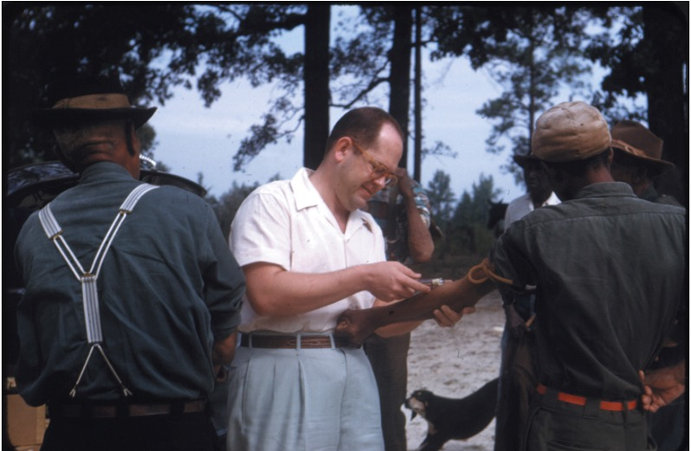
The Tuskegee Syphilis Study
Unethical choices
  The participants were not treated respectfully (researchers lied to them about their disease).
  The participants were discouraged from seeking other medical care.
  The participants (and their families) were severely harmed, and many died.
  The participants were a targeted, disadvantaged social group.

Slide 7
Belmont Report
Written after Tuskegee, at request of Congress
Outlines three main principles:
  Respect for persons
  Beneficence
  Justice
Nuremberg Code after WWII

Slide 8
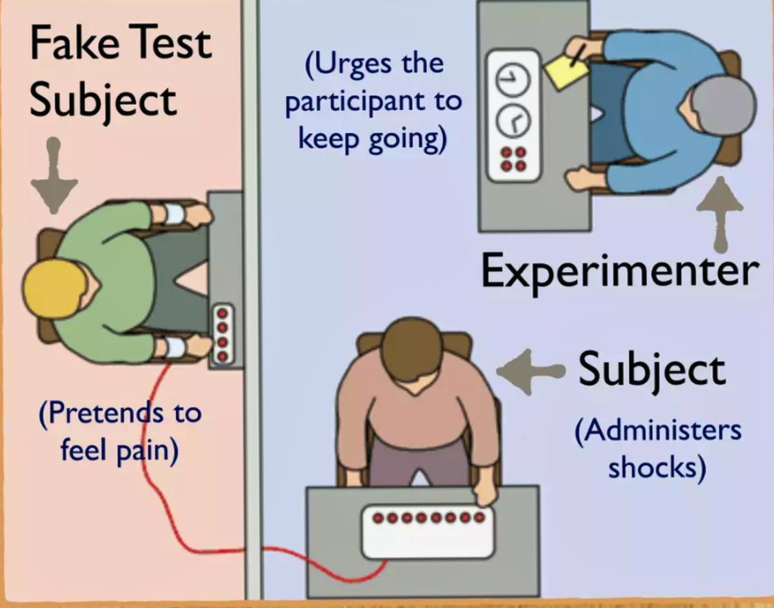
The Milgram Obedience Studies
Prod 1: Please continue. or Please go on.
Prod 2: The experiment requires that you continue.
Prod 3: It is absolutely essential that you continue.
Prod 4: You have no other choice, you must go on.

Slide 9
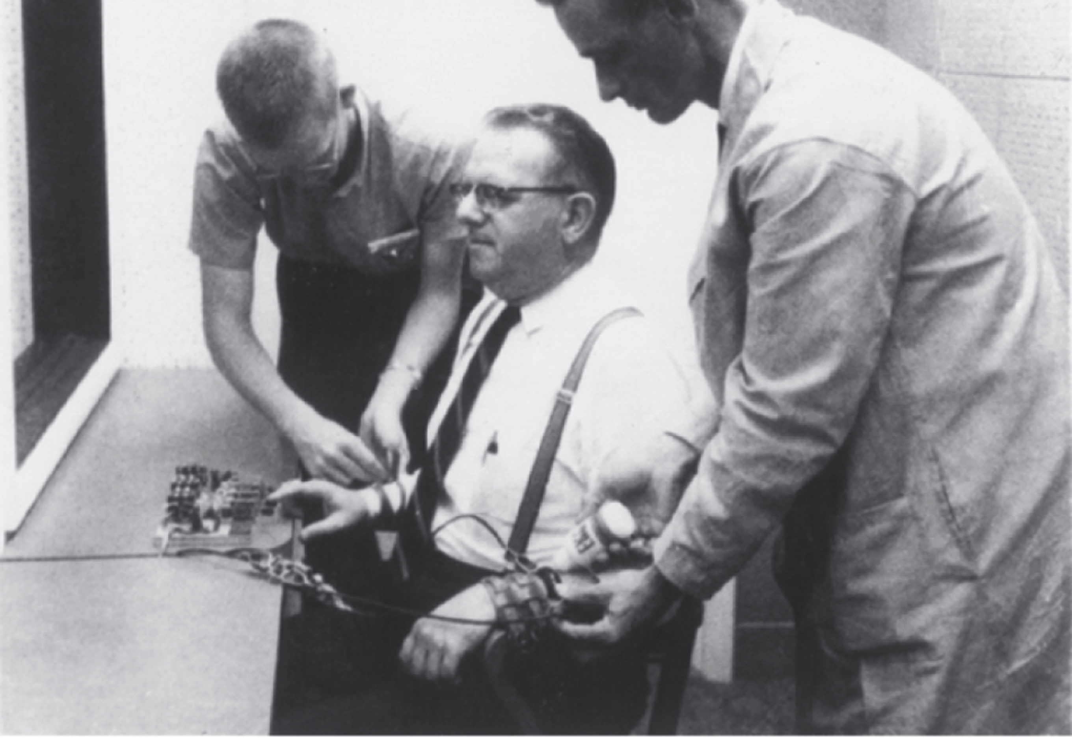
The Milgram Obedience Studies
Unethical choices
  Participants didn’t know they could withdraw at any time
  Let the participants become extremely distressed (crying, trembling, sweating, and panic attacks)
  No debriefing

Slide 10
APA & The War on Terror
Post-9/11: U.S. government sought intelligence from suspected terrorists held at Guantánamo Bay and other detention sites
2002 APA Ethics Code: If ethics conflicted with law or other governing authority, psychologists could ultimately “adhere to” that authority
  Originally oriented towards things like court orders and other civil matters, but opened a door for psychologists to play a part in the
2005 Presidential Task Force on Psychological Ethics and National Security (PENS Task Force): APA determined psychologists could ethically participate in national-security interrogations
Psychologists were recruited to advise interrogation programs, including techniques involving fear, stress, isolation, sleep deprivation, and other forms of psychological “pressure”

Slide 11
The Pushback
Psychologists inside and outside APA raised concerns about psychologists' involvement in interrogations
2015 Hoffman Report: Independent investigation found that some APA officials colluded with Department of Defense officials
  The review is available here: https://www.apa.org/independent-review
  Investigators concluded APA officials sought loose ethical guidelines that would not impose greater restrictions than existing military rules
The scandal resulted in major leadership consequences, including firing/resignations/early retirements of senior APA officials

Slide 12
The Ethical Reform
APA prohibited psychologists from participating in certain national-security interrogations and strengthened its ethics policies
In 2010, APA deleted the language saying psychologists could ultimately follow governing legal authority and replaced it with:
  “Under no circumstances may this standard be used to justify or defend violating human rights.”
And in 2016, APA amended Standard 3.04, Avoiding Harm, to explicitly state that psychologists may not:
  “participate in, facilitate, assist, or otherwise engage in torture”
Key lesson: “Legal” or “ordered by an authority” ≠ “ethical”

Slide 13
Ethical Principles
APA Guidelines
Application for Psychologists

Slide 14
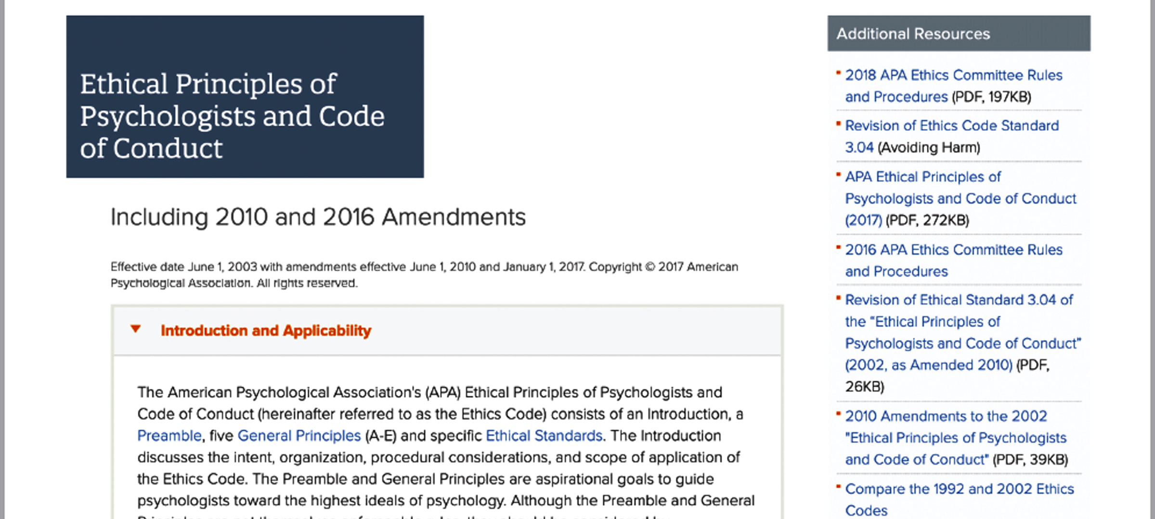
Guidelines for Psychologists: APA Ethical Principles

Slide 15

Three Core Principles of Belmont Report
  The Belmont Report: Principles and applications
    Principle of respect for persons
      Informed consent
    Principle of beneficence or concern for welfare
      Assess potential harm to participants and potential benefits to society.
    Principle of justice
      Who bears the burden of research participation?

Slide 16
The APA Ethical Principles
The Five APA Ethical Principles
  Developed to protect Ps, but also students and clients
  Three are identical to Belmont Report’s Principles:
    Beneficence and nonmaleficence
    Justice
    Respect for people’s rights and dignity
  Two additional principles apply to research, teaching, and clinical practice
    Fidelity and responsibility
    Integrity

Slide 17
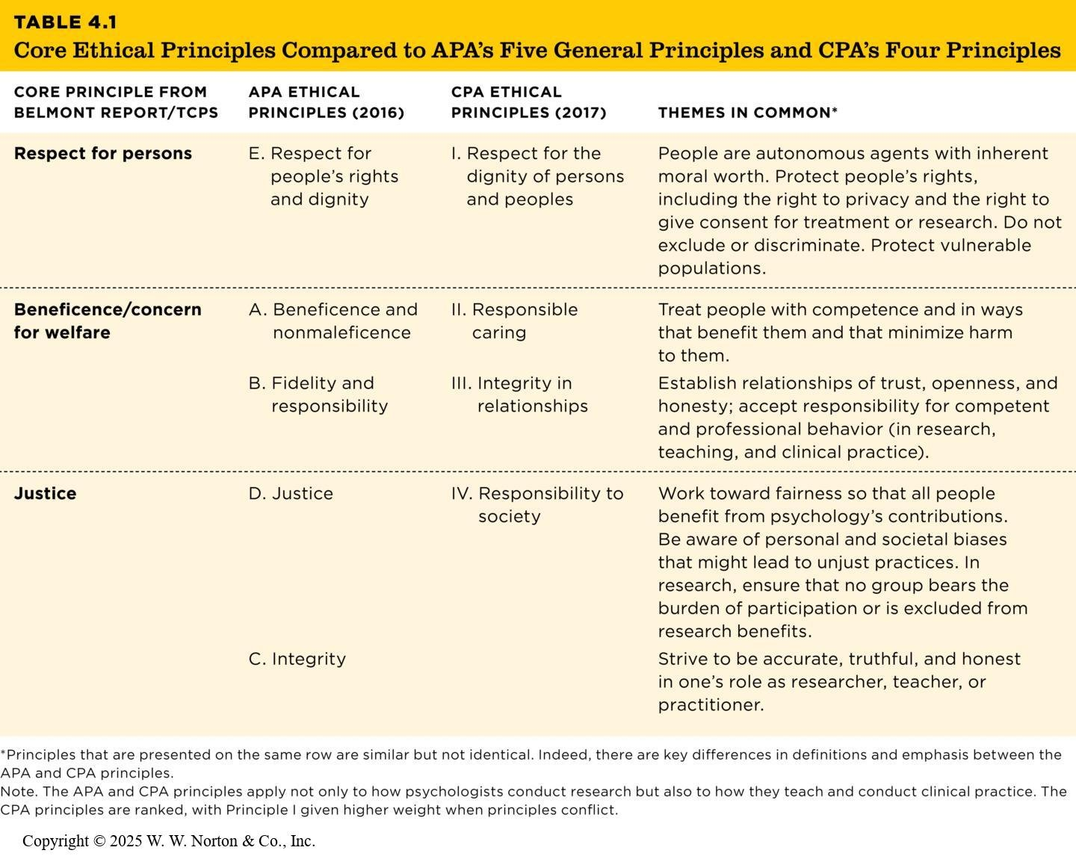
Belmont Plus Two: APA’s Five General Principles
Table 4.1
Table 4.1 Core Ethical Principles Compared to APA’s Five General Principles and CPA’s Four Principles
Core Principle from Belmont Report/TCPS | APA Ethical Principles (2016) | CPA Ethical Principles (2017) | Themes in Common*
Respect for persons | E. Respect for people’s rights and dignity | I. Respect for the dignity of persons and peoples | People are autonomous agents with inherent moral worth. Protect people’s rights, including the right to privacy and the right to give consent for treatment or research. Do not exclude or discriminate. Protect vulnerable populations.
Beneficence/concern for welfare | A. Beneficence and nonmaleficence | II. Responsible caring | Treat people with competence and in ways that benefit them and that minimize harm to them.
 | B. Fidelity and responsibility | III. Integrity in relationships | Establish relationships of trust, openness, and honesty; accept responsibility for competent and professional behavior (in research, teaching, and clinical practice).
Justice | D. Justice | IV. Responsibility to society | Work toward fairness so that all people benefit from psychology’s contributions. Be aware of personal and societal biases that might lead to unjust practices. In research, ensure that no group bears the burden of participation or is excluded from research benefits.
 | C. Integrity |  | Strive to be accurate, truthful, and honest in one’s role as researcher, teacher, or practitioner.
Principles that are presented on the same row are similar but not identical. Indeed, there are key differences in definitions and emphasis between the APA and CPA principles.
Note. The APA and CPA principles apply not only to how psychologists conduct research but also to how they teach and conduct clinical practice. The CPA principles are ranked, with Principle I given higher weight when principles conflict.

Slide 18
Ethical Practices for Psychologists: APA and CPA Ethics Codes
Ethical standards for research common to the APA and CPA
  Ethics training
  Institutional review boards, research ethics boards
  Informed consent
  Deception
  Debriefing
  Research misconduct
    Data fabrication and data falsification
    Ethics of openness and transparency
    Plagiarism, including self-plagiarism

Slide 19

Ethical Practices for Psychologists: APA and CPA Ethics Codes
Animal research

Slide 20
Animal Research Practices
Purpose of animal research
  Test hypotheses unethical to study in humans
Ethical considerations
  Balance human benefits with animal welfare
  Prevent unnecessary suffering

Slide 21
Examples of Animal Research
Harlow’s Studies (1950s–60s)
Songbird Research (Lattin et al., 2012, 2014)

Slide 22
Legal, Institutional, and Moral Frameworks
In the United States, the Animal Welfare Act (AWA, 1966) outlines standards for the ethical treatment of animals in research, although it excludes commonly studied species like mice, rats, and birds.
Researchers must also comply with local and institutional requirements. Every research institution must have an Institutional Animal Care and Use Committee (IACUC) in the United States or an Animal Care Committee (ACC) in Canada.
These committees, composed of veterinarians, scientists, community members, and students, approve research protocols before projects begin, ensuring animal welfare and scientific justification. They monitor compliance throughout the research process and have the authority to halt experiments or withdraw funding for violations.

Slide 23
Legal, Institutional, and Moral Frameworks
Animal care guidelines and the three R’s (outlined by Russell and Burch (1959)):
    Replacement
    Refinement
    Reduction

Slide 24
Legal, Institutional, and Moral Frameworks
Many animals, as demonstrated by the Cambridge Declaration of Consciousness (2012), are sentient and capable of experiencing pain, emotion, and consciousness.
Modern frameworks, such as those proposed by DeGrazia and Beauchamp (2019), emphasize two core values:
  Social benefit
  Animal welfare

Slide 25
Ethical Decision Making: A Thoughtful Balance
Ethical decision making requires a balance of priorities.
We need to weigh the potential harm to human or animal participants against what the knowledge gained from the research will contribute to society.

Slide 26
Next Time on PSY 270…
Before Next Class(es):
Read Chapter 4 and complete Ebook: Chapter 4 assignment
  Due 9/18 at 11:59 pm
Complete InQuizitive: Chapter 4
  Due 9/18 at 11:59 pm
Next Class:
Exam 1 Review

